Slide 1
COVID-19/SARS-CoV-2 & back to school
September 3, 2020
Dr. Dawn Bowdish, PhD
Canada Research Chair in Aging & Immunity
McMaster University
bowdish@mcmaster.ca
www.bowdish.ca
Twitter & Instagram: @MsMacrophage
Part 1

Slide 2
Can schools open safely?
Only with vigilance, adaptability and major adjustments.

Slide 3
No evidence of increased transmission
Evidence of spread between students, not teachers
Major outbreaks, evidence of spread
Heavey et al. Euro Surveill. 2020;25(21):pii=2000903. https://doi.org/10.2807/1560-7917.ES.2020.25.21.2000903
Macartney, Kristine, et al. "Transmission of SARS-CoV-2 in Australian educational settings: a prospective cohort study." The Lancet Child & Adolescent Health (2020).

Slide 4
Heavey et al. Euro Surveill. 2020;25(21):pii=2000903. https://doi.org/10.2807/1560-7917.ES.2020.25.21.2000903
Macartney, Kristine, et al. "Transmission of SARS-CoV-2 in Australian educational settings: a prospective cohort study." The Lancet Child & Adolescent Health (2020).

Slide 5
SARS-CoV-2
influenza
RSV
(respiratory syncytial virus)
Rhinovirus
Adenovirus
Common but serious
Common colds

Slide 6
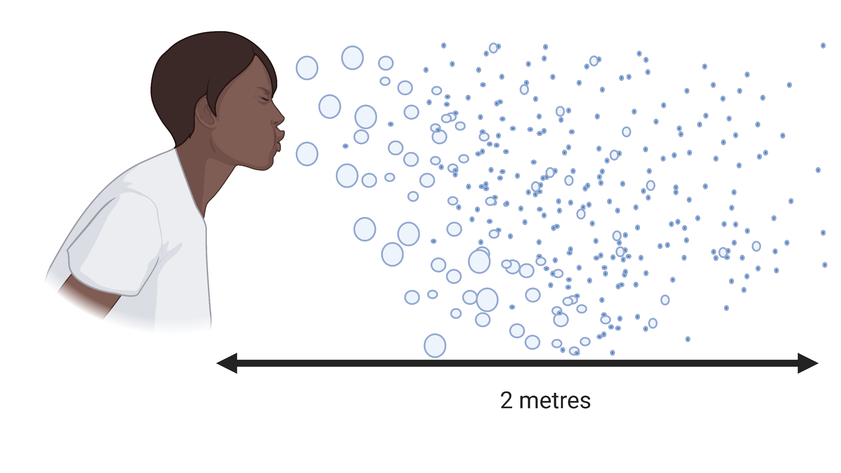

Slide 7
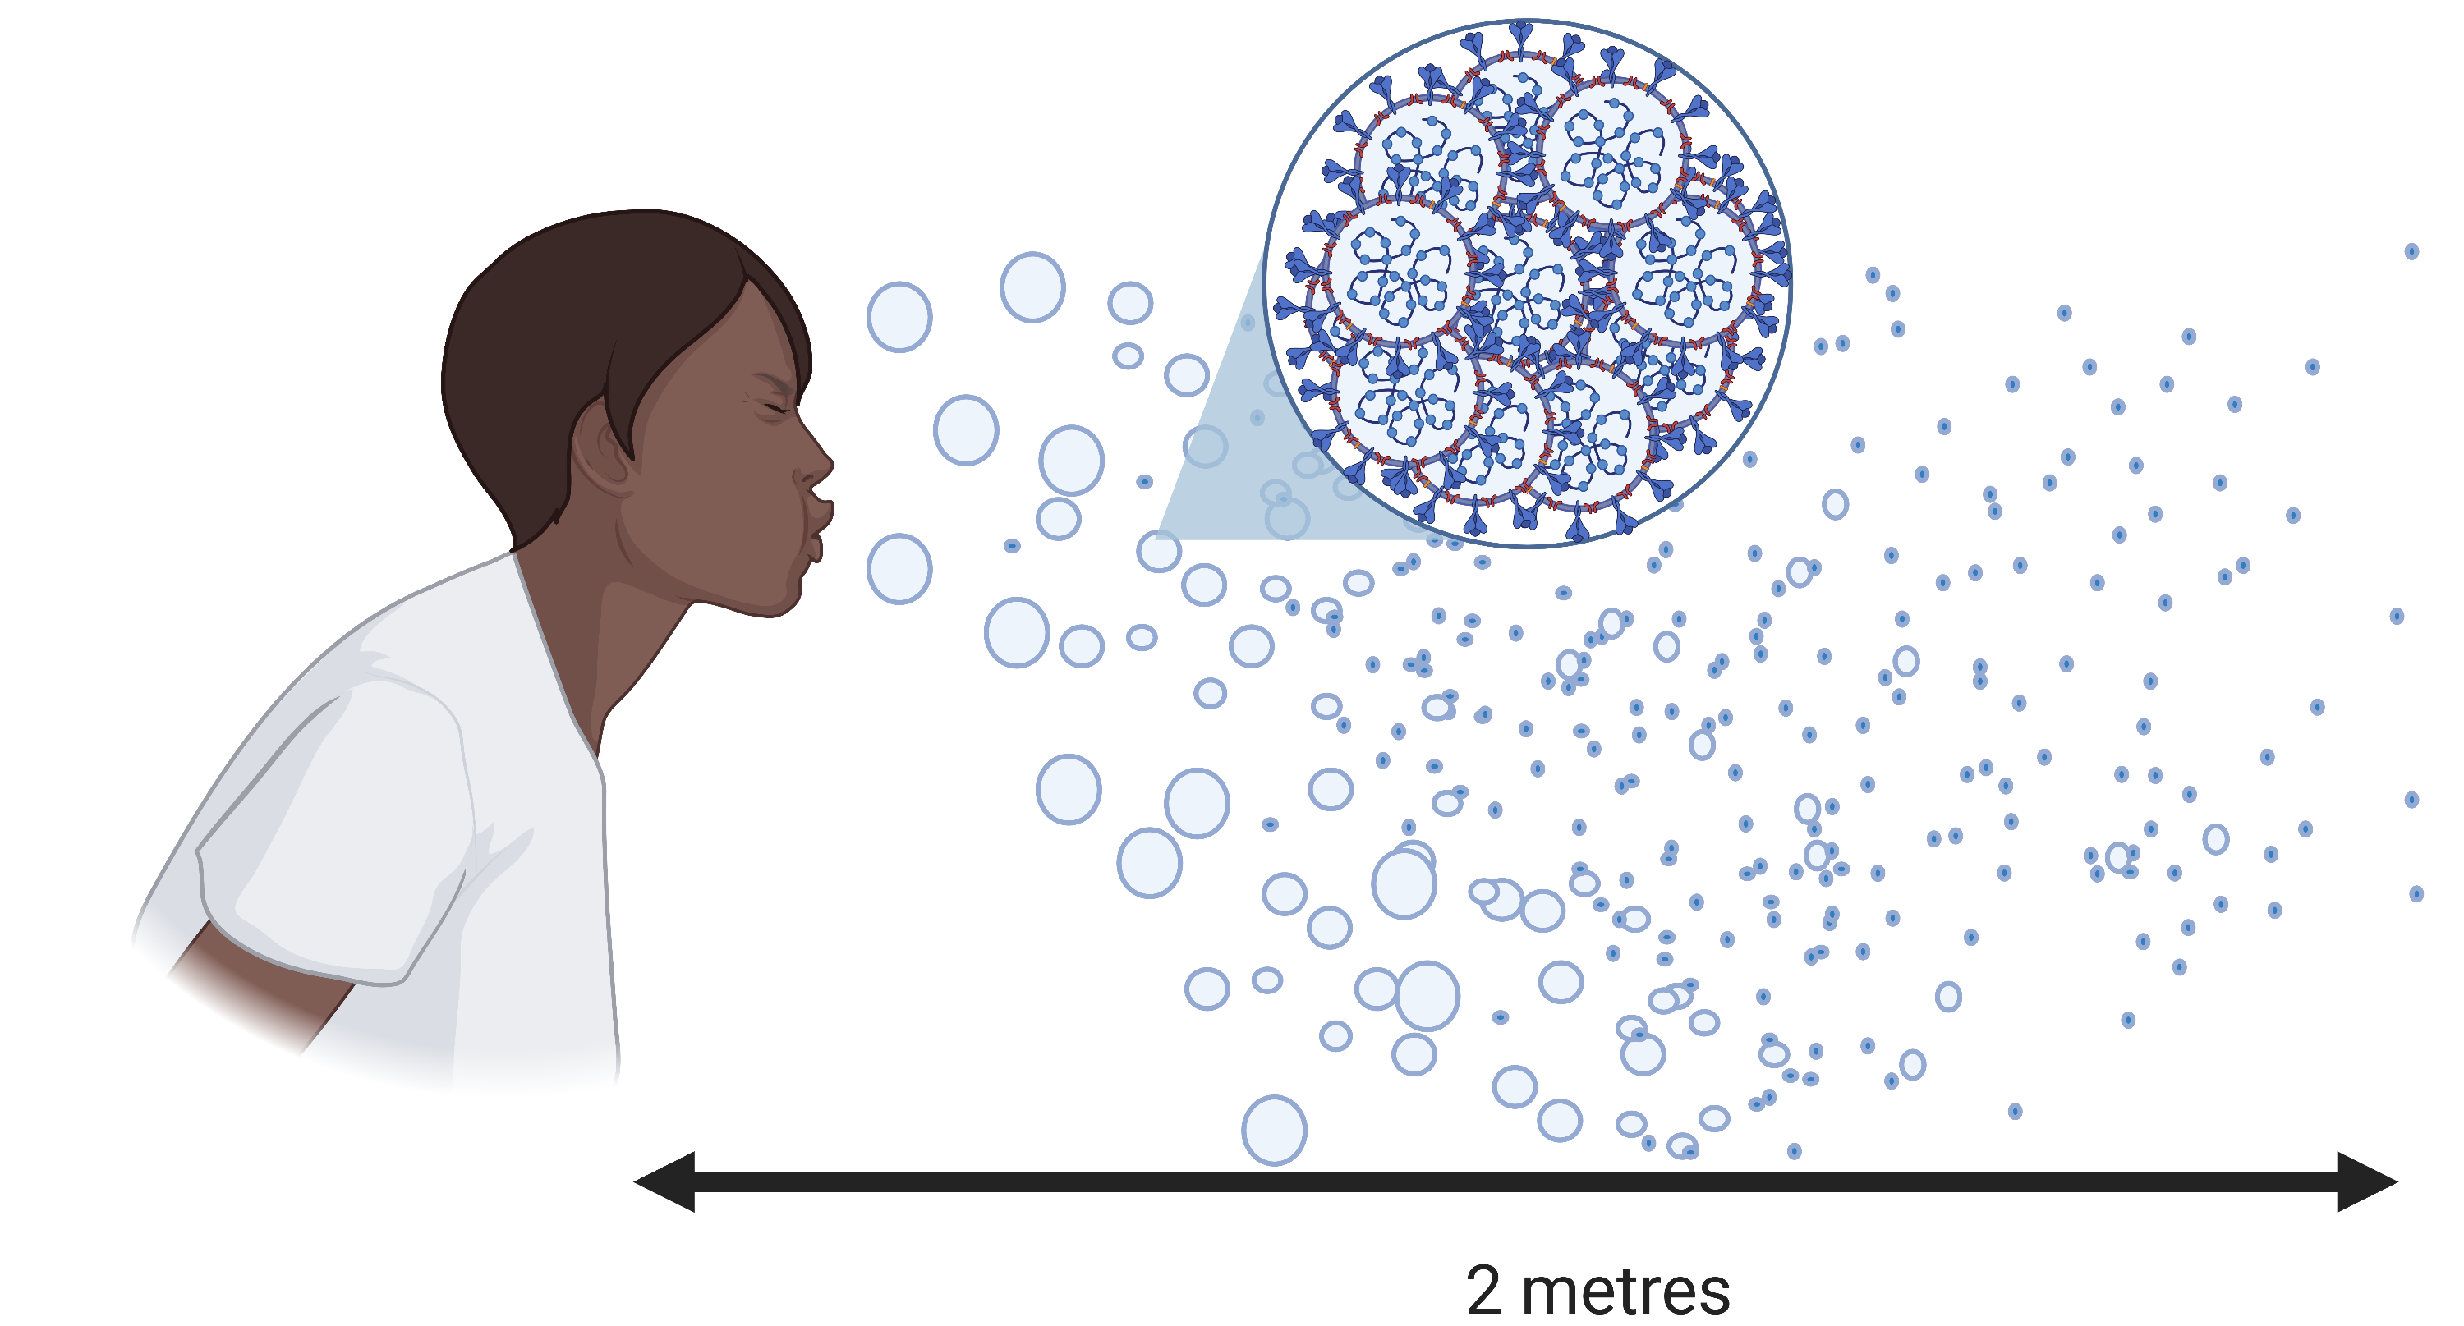

Slide 8
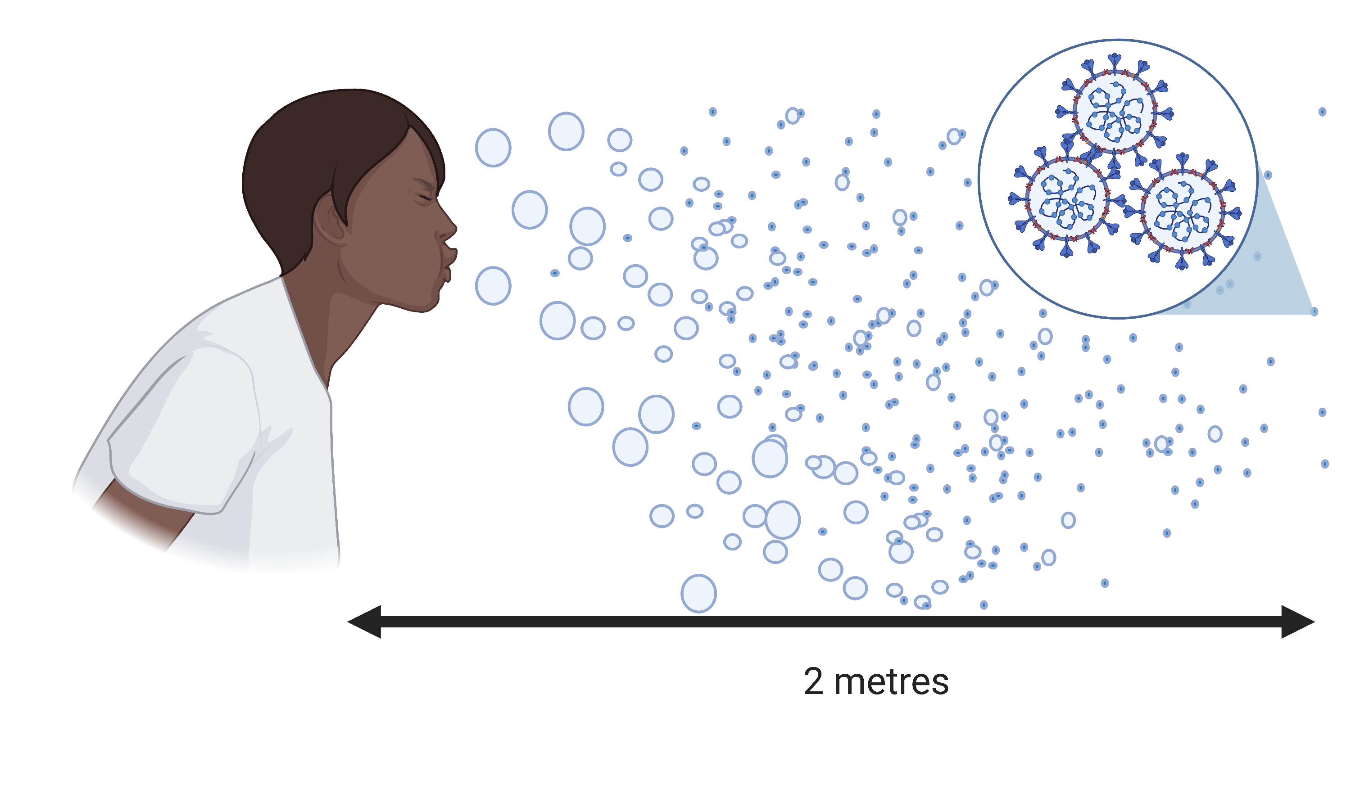

Slide 9
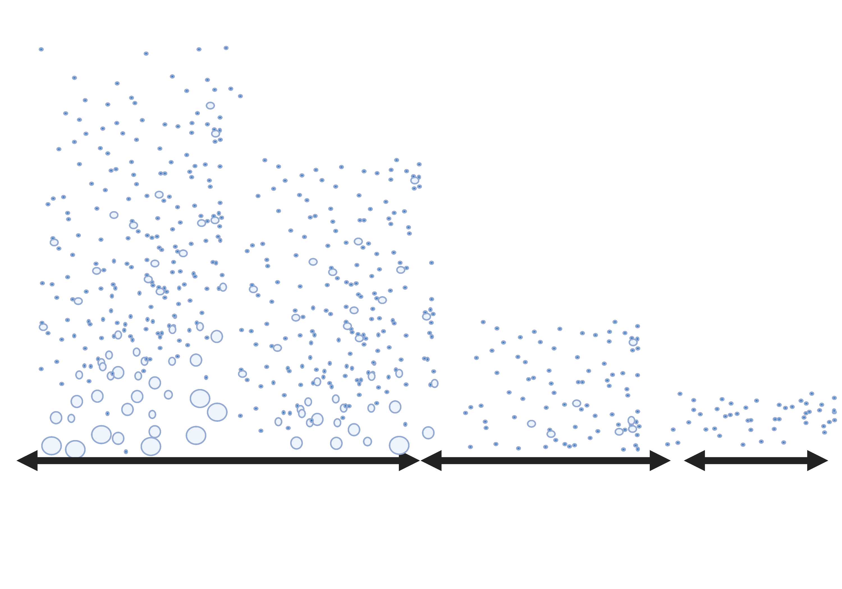
Coughing/
Sneezing
Singing/
Shouting
Talking
Breathing
5 – 15 min
45 min
45 min+

Slide 10
Coughing/
Sneezing
Singing/
Shouting
Talking
Breathing
Symptomatic
Asymptomatic
5 – 15 min
45 min
45 min+

Slide 11
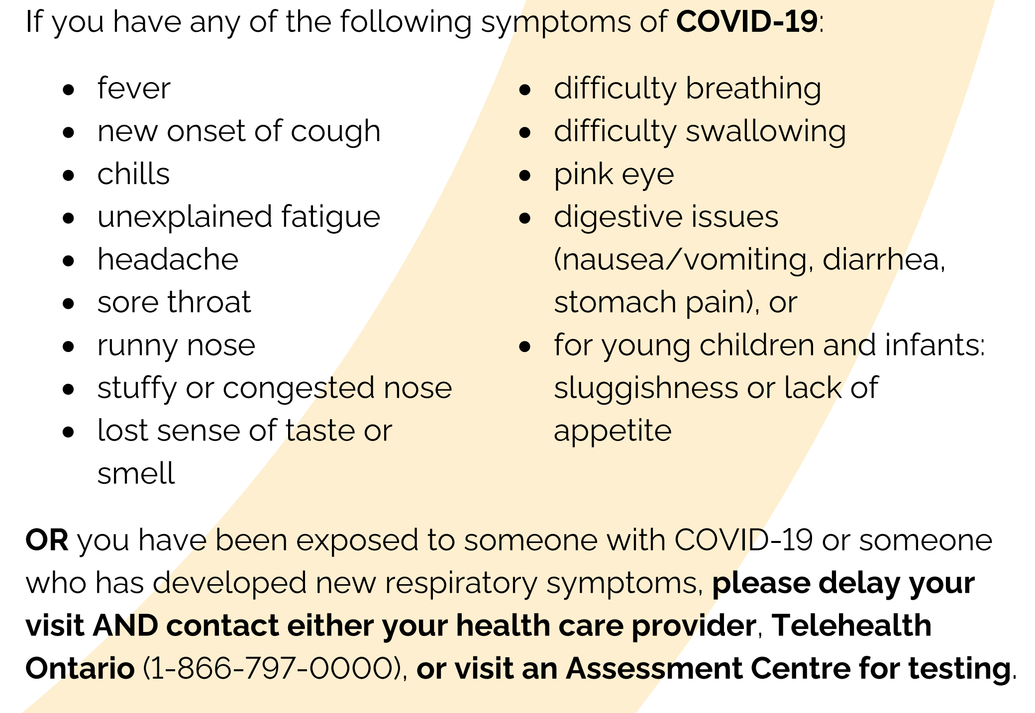
Symptoms – adults vs kids
Up to 90% of kids may be missed because their symptoms are mild!
Han MS, et al. Clinical Characteristics and Viral RNA Detection in Children With Coronavirus Disease 2019 in the Republic of Korea. JAMA Pediatrics. doi:10.1001/jamapediatrics.2020.3988

Slide 12
Most common
1 in 3 kids had;
Mild fever (37.5-<38˚C)
Cough
Sputum
Common
1 in 4 kids had;
High fever (≥38˚C)
Runny nose
Sore throat
Less common
1 in 10 kids had;
Headache
Diarrhea
Loss of taste
Infrequent
(<1/10 kids)
Body aches, lethargy, chills, congestion, chest discomfort, shortness of breath, abdominal pain, nausea or vomiting, loss of smell, eye pain
Han MS, et al. Clinical Characteristics and Viral RNA Detection in Children With Coronavirus Disease 2019 in the Republic of Korea. JAMA Pediatrics. doi:10.1001/jamapediatrics.2020.3988

Slide 13
Why do children spread less?
Simply: They are less likely to cough and sneeze.
https://www.health.nsw.gov.au/Infectious/covid-19/Documents/covid-19-surveillance-report-20200829.pdf

Slide 14
Beware the Second Wave!
We may see a lot more spreading soon.

Slide 15
SARS-CoV-2
influenza
RSV
(respiratory syncytial virus)
Rhinovirus
Adenovirus
Common but serious
Common colds

Slide 16
Australian cold & flu season
https://www.health.nsw.gov.au/Infectious/covid-19/Documents/covid-19-surveillance-report-20200829.pdf

Slide 17
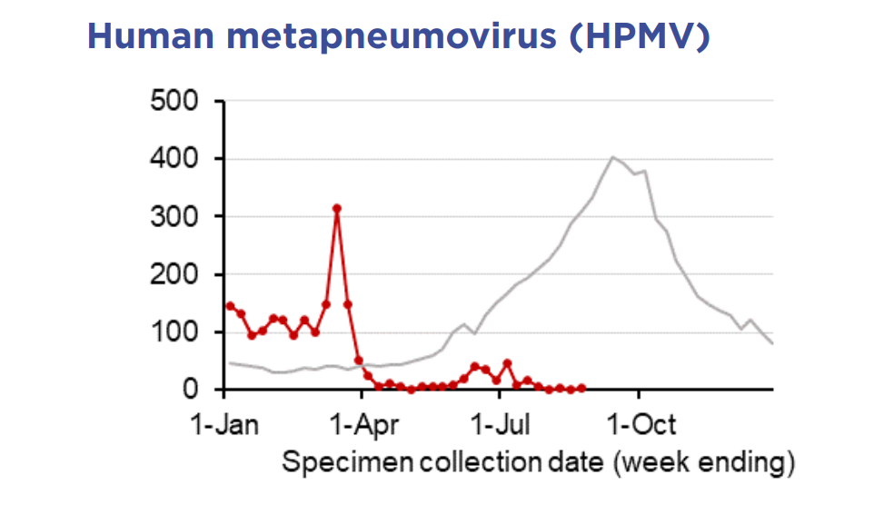
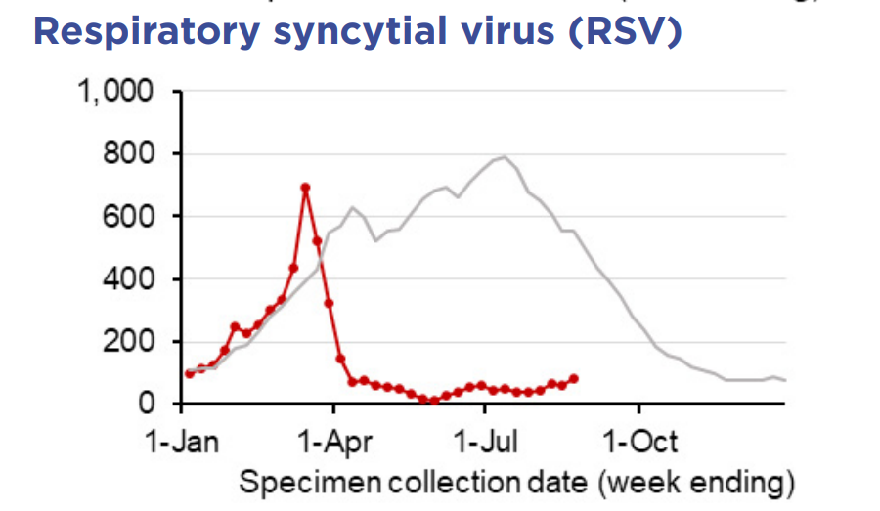
Australian cold & flu season
https://www.health.nsw.gov.au/Infectious/covid-19/Documents/covid-19-surveillance-report-20200829.pdf

Slide 18
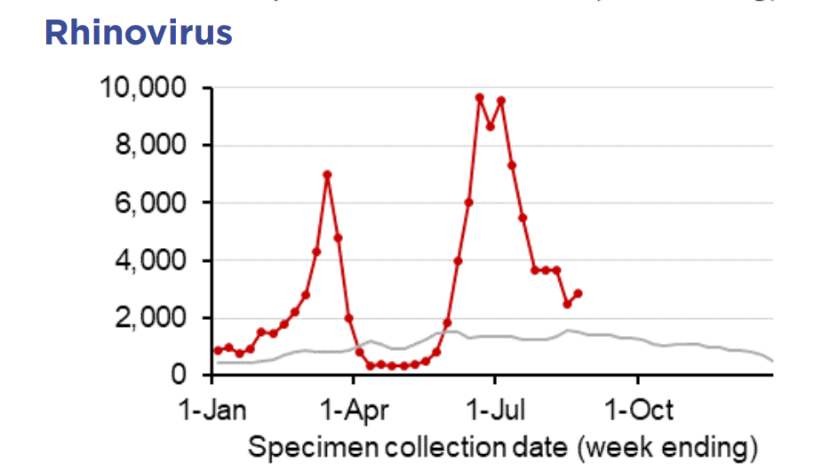
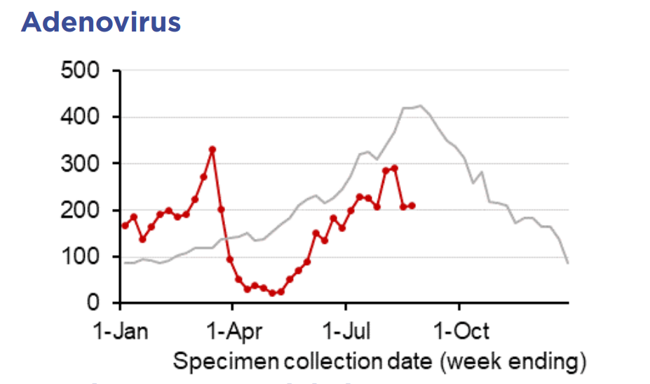
Australian cold & flu season
https://www.health.nsw.gov.au/Infectious/covid-19/Documents/covid-19-surveillance-report-20200829.pdf

Slide 19
Breathing
Talking
Coughing/Sneezing

Slide 20
Priority #1 – keep symptomatic kids out of school
Screen kids for symptoms before they enter school.
Forehead fever testing
Any symptoms no matter how mild? Get tested or wait until they’ve resolved.
Don’t send kids who’ve taken Tylenol/Ibuprofen to school – it can mask symptoms. Allergy medicine = okay.
Expect a lot of absences in cold/flu season.
Masks, distancing, hand hygiene.
Next talk: Ventilation concerns & other strategies to keep infections low.

Slide 21
References & attributions
Figures made with Biorender.com
Anatomy of a sneeze
Outbreaks or lack thereof associated with school re-opening.
Characterizations of particle size distribution of the droplets exhaled by sneeze Z. Y. Han, et al
https://royalsocietypublishing.org/doi/full/10.1098/rsif.2013.0560
Fontanet, A., et al. "SARS-CoV-2 infection in primary schools in northern France: A retrospective cohort study in an area of high transmission." MedRxiv (2020).
Viner, Russell M., et al. "School closure and management practices during coronavirus outbreaks including COVID-19: a rapid systematic review." The Lancet Child & Adolescent Health (2020).
Yung, Chee Fu, et al. "Novel coronavirus 2019 transmission risk in educational settings." Clinical Infectious Diseases (2020).
Summary of schools re-opening
Summary of School Re-Opening Models and Implementation
Approaches During the COVID 19 Pandemichttps://globalhealth.washington.edu/sites/default/files/COVID-19%20Schools%20Summary%20%28updated%29.pdf
To download the .ppt slides go to www.bowdish.ca
If modifying please attribute the original publication/data source.

